Slide 1
CS 162 Over Enrolled (400) for 245 Li Ka Shing (~300 seats)
CoE Dean Sastry asked us to fulfill the department's responsibilities:
To enforce fire code, up to refusing to continue with lecture should that become necessary. Everyone must have a seat in the room
To webcast the lecture so in the unexpected event that the room is overcrowded and students are turned away, they will still have access to all course content. https://calcentral.berkeley.edu/academics/semester/spring-2018
To communicate very prominently in any printed and online materials that if the lecture hall reaches capacity at any time, students will be turned away and directed to the webcast.
The link for this will be provided to ensure that students don’t miss part of the class searching for the webcast version.
To ensure that special provision is afforded to accommodate the needs of any disabled students for whom watching the lecture online would adversely affect their learning outcomes compared to attending the lecture in person.
Course recordings will be posted on CalCentral within 12 hours
https://calcentral.berkeley.edu/academics/semester/spring-2018
Select COMPSCI 162

Slide 2
CS162 Operating Systems and Systems Programming Lecture 1 What is an Operating System?
January 17th, 2018
Profs. Anthony D. Joseph and Jonathan Ragan-Kelley
http://cs162.eecs.Berkeley.edu

Slide 3
Who Am I?
Anthony D. Joseph
465 Soda Hall (RISE Lab)
Web: http://www.cs.berkeley.edu/~adj/
Office hours: TBD
Teach BerkeleyX MOOCs on the side
Big Data and Apache Spark (‘15/’16 >240k students with >11% finishing)
Research areas:
Cancer Genomics/Precision Medicine (ADAM/Apache Spark), Secure Machine Learning (SecML), DETER security testbed
Previous: Cloud computing (Apache Mesos), Peer-to-Peer networking (Tapestry), Mobile computing, Wireless/Cellular networking
Campus Cyber-Risk Responsible Executive, co-chair dept IT cmte
Notes:
Mesos – Apple, Netflix, Twitter, Yelp, Airbnb, Groupon, Ebay, PayPal
Spark – Amazon, Baidu, Ebay, Groupon,Yahoo!

Slide 4
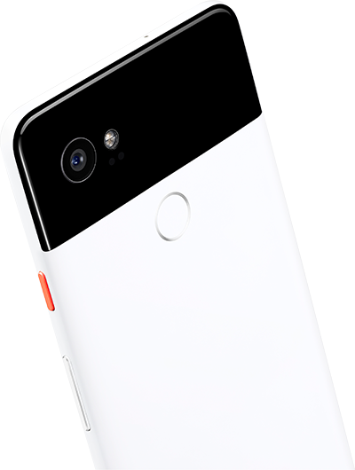


Who am I?
Jonathan Ragan-Kelley
525 Soda Hall (Visual Computing Lab)
Web: http://www.cs.berkeley.edu/~jrk/
Office hours: TBD
Research areas:
Applying systems, compilers, programming languages, and architecture to graphics, vision, machine learning, and computational imaging
Making it easy to write faster programs, build more efficient systems e.g., http://halide-lang.org
Previously: Stanford (boo), MIT, Lucasfilm, Google,

Slide 5
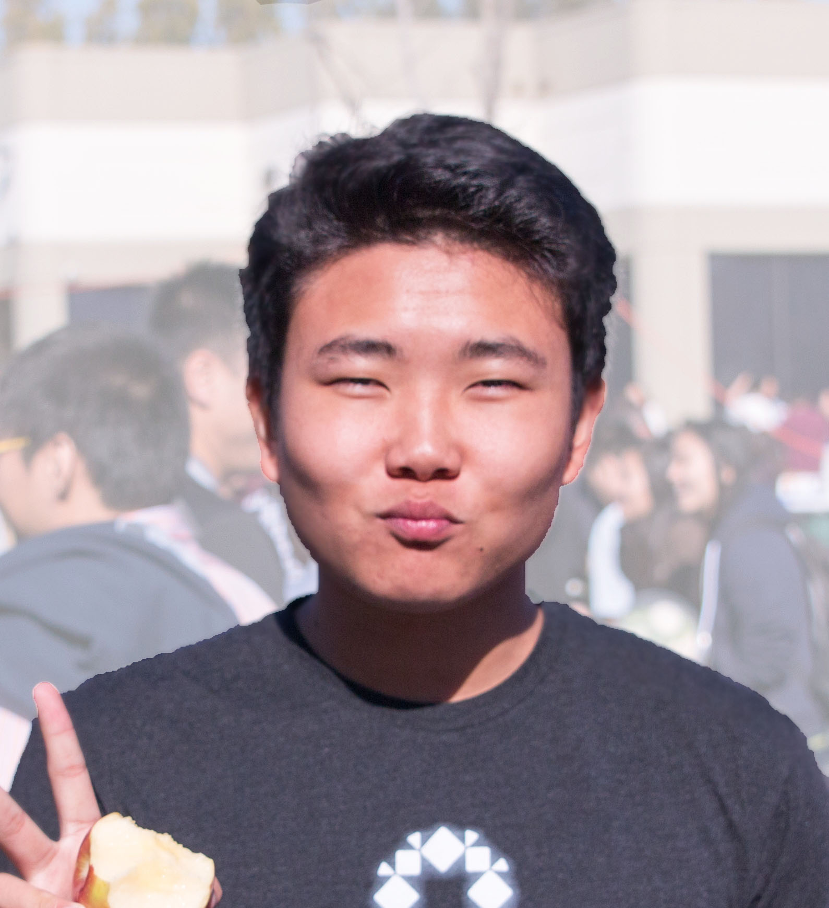
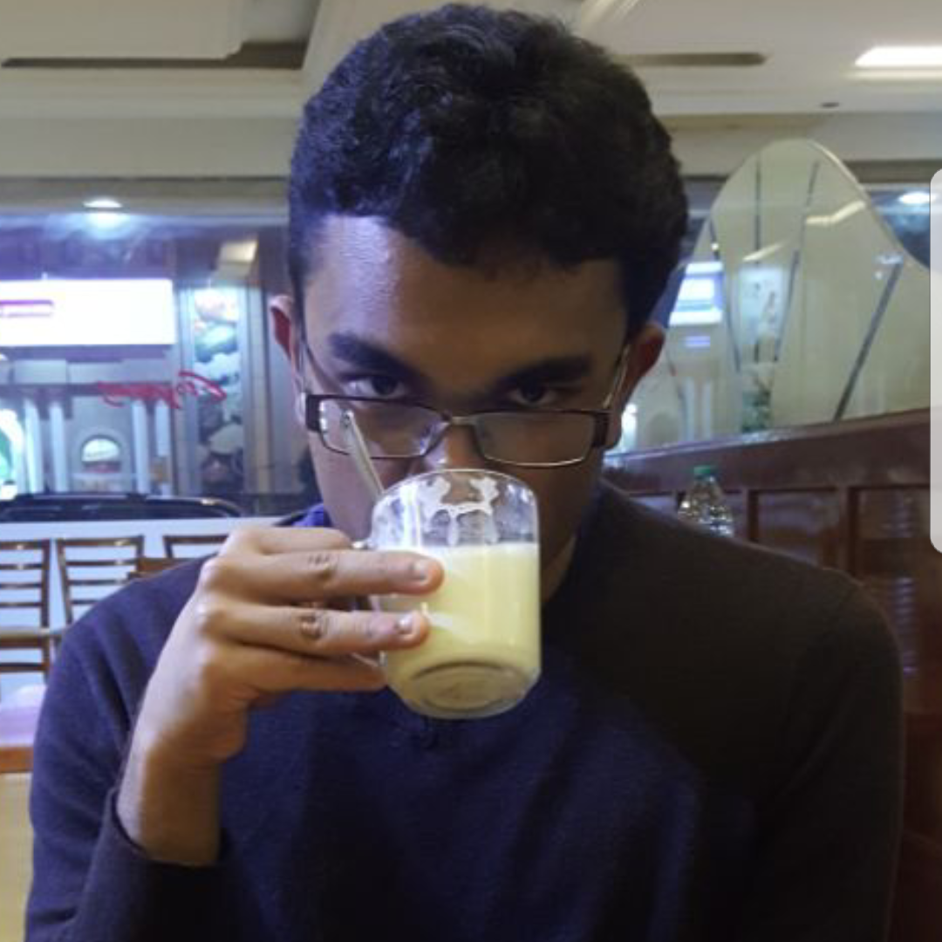
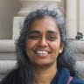
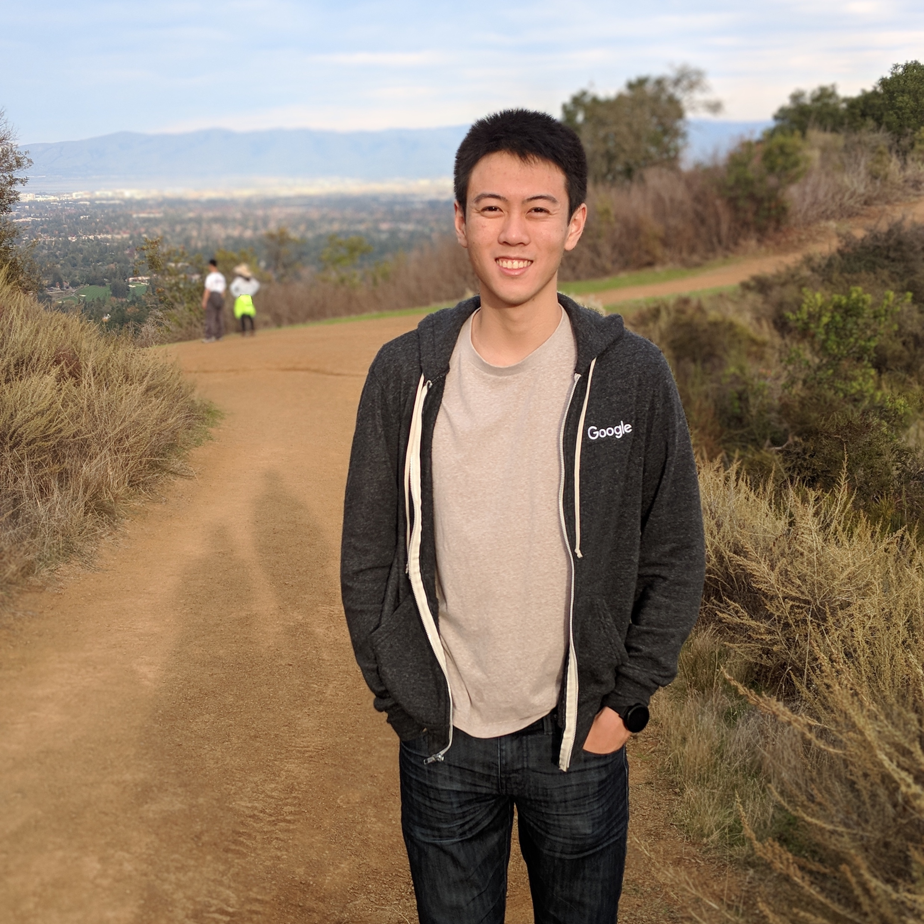
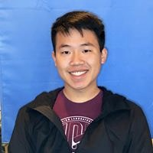
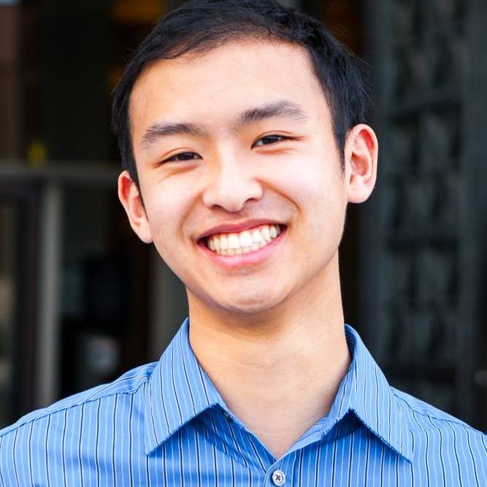
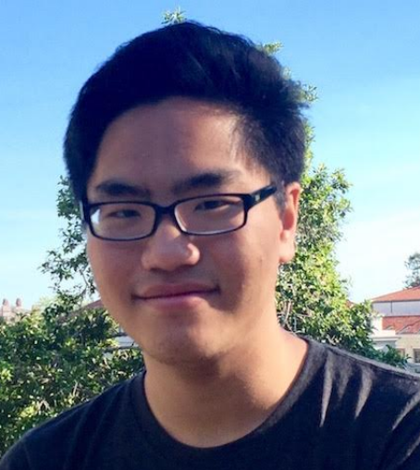
“The Magnificent Seven” - CS162 TAs
Eric Hou
Nitin Manivasagan
Kalyanaraman Shankari
William Sheu
Jack Yang
Patrick Yang
Justin Yum (Head TA)

Slide 6
This and Next Week
Sections on Fridays – attend any section you want
We’ll assign permanent sections after forming project groups
This week will help us determine the section balance
This is an Early Drop Deadline course (Friday January 26th)
If you are not serious about taking, please drop early
Dept will continue to admit students as other students drop
On the waitlist ???
We are at capacity, but waitlist will be processed through Mon 1/29

Slide 7
Goals for Today
What is an Operating System?
And – what is it not?
What makes Operating Systems so exciting?
Oh, and “How does this class operate?”
Interactive is important!
Ask Questions!
Slides courtesy of David Culler, Anthony D. Joseph, John Kubiatowicz, AJ Shankar, George Necula, Alex Aiken, Eric Brewer, Ras Bodik, Ion Stoica, Doug Tygar, and David Wagner.

Slide 8
What is an operating system?
Special layer of software that provides application software access to hardware resources
Convenient abstraction of complex hardware devices
Protected access to shared resources
Security and authentication
Communication amongst logical entities
appl n
appln
appln
OS
Hardware

Slide 9
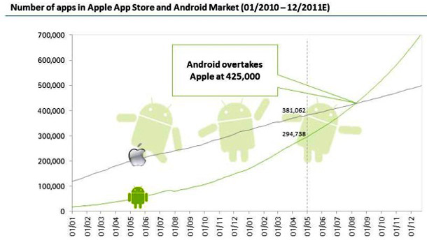
What Does an OS do?
Provide abstractions to apps
File systems
Processes, threads
VM, containers
Naming system
…
Manage resources:
Memory, CPU, storage, …
Achieves the above by implementing specific algos and techniques:
Scheduling
Concurrency
Transactions
Security
…..

Slide 10
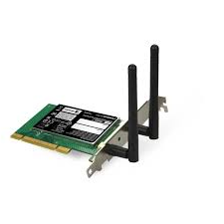
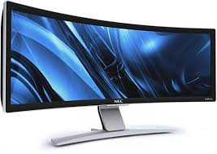

OS Basics: “Virtual Machine” Boundary
Threads
Address Spaces
Windows
Processes
Files
Sockets
Software
OS Hardware Virtualization
Hardware
Instruction Set
Architecture (ISA)
Memory
Processor
Networks
storage
Displays
Inputs

Slide 11
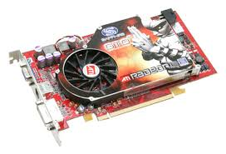
OS Basics: Program => Process
Threads
Address Spaces
Windows
Processes
Files
Sockets
Software
OS Hardware Virtualization
Hardware
ISA
Memory
Processor
OS
storage
Networks
Displays
Inputs

Slide 12
OS Basics: Context Switch
Threads
Address Spaces
Windows
Processes
Files
Sockets
Software
OS Hardware Virtualization
Hardware
ISA
Memory
Processor
OS
storage
Networks
Displays
Inputs

Slide 13
OS Basics: Scheduling, Protection
Threads
Address Spaces
Windows
Processes
Files
Sockets
Software
OS Hardware Virtualization
Hardware
ISA
Memory
Processor
Protection Boundary
OS
storage
Networks
Displays
Inputs

Slide 14
OS Basics: I/O
Threads
Address Spaces
Windows
Processes
Files
Sockets
Software
OS Hardware Virtualization
Hardware
ISA
Memory
Processor
Protection Boundary
OS
Ctrlr
storage
Networks
Displays
Inputs

Slide 15
OS Basics: Loading
Threads
Address Spaces
Windows
Processes
Files
Sockets
Software
OS Hardware Virtualization
Hardware
ISA
Memory
Processor
Protection Boundary
OS
Ctrlr
storage
Networks
Displays
Inputs

Slide 16


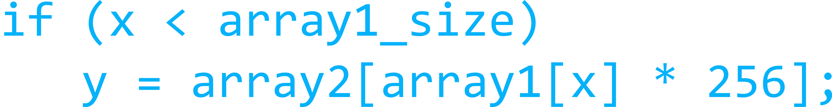
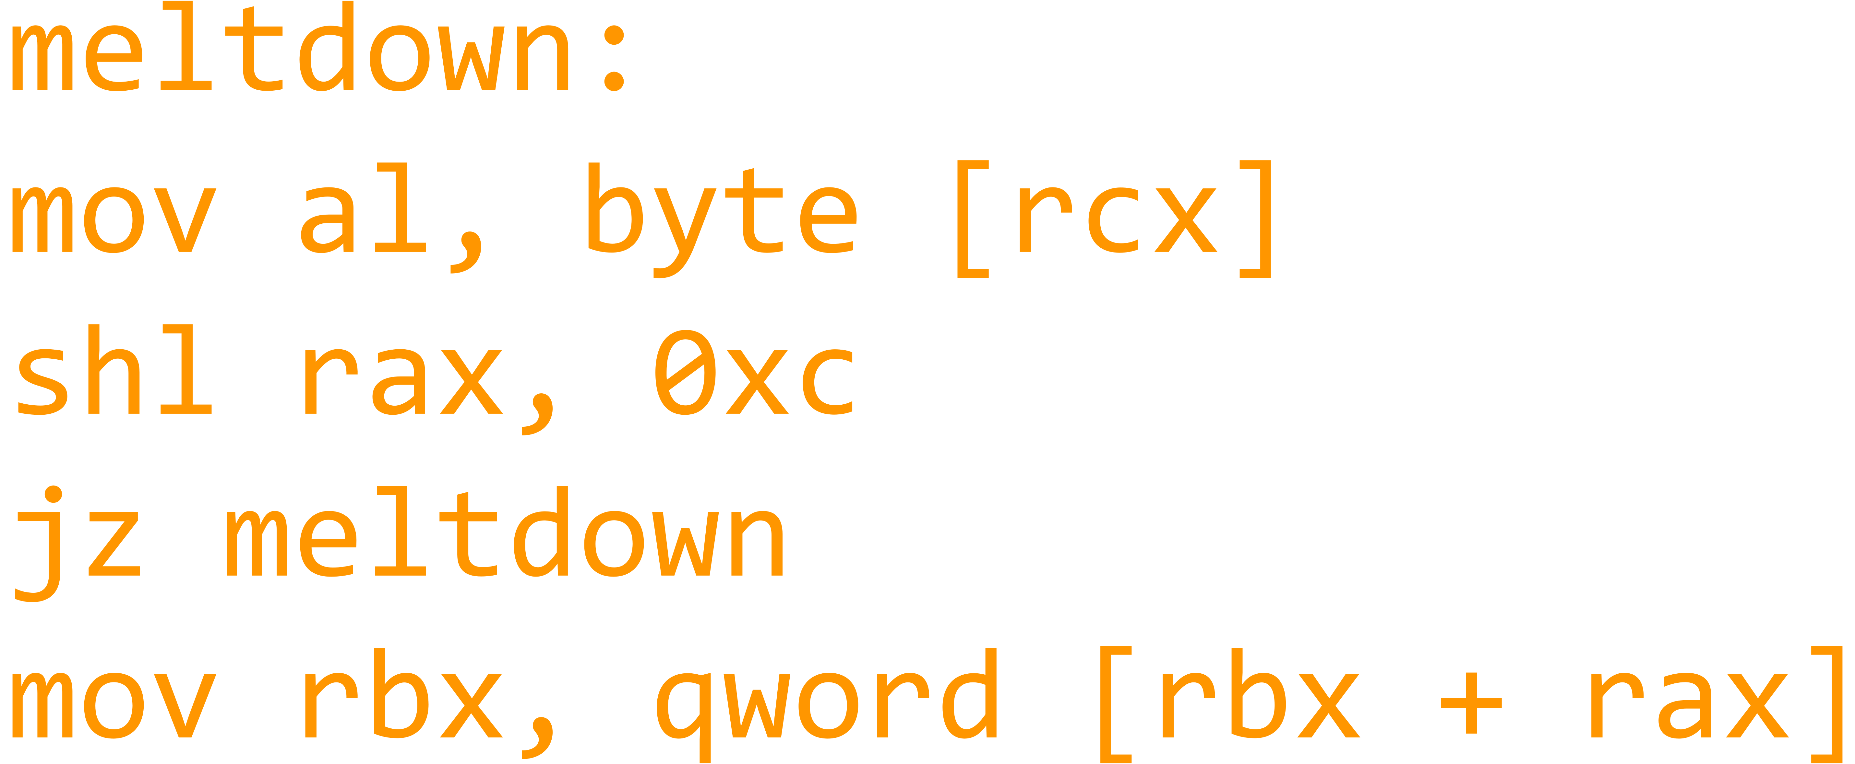
What makes Operating Systems Exciting and Challenging?

Slide 17
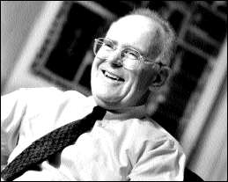
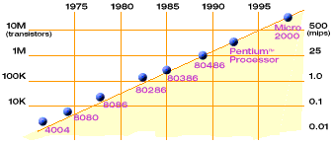
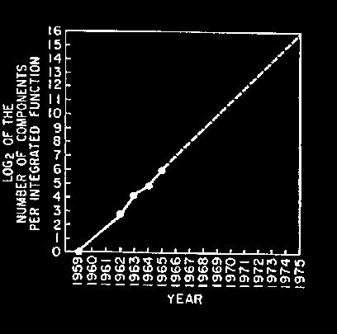
Technology Trends: Moore’s Law
Moore’s Law
2X transistors/Chip Every 1.5 years
Called “Moore’s Law”
Gordon Moore (co-founder of Intel) predicted in 1965 that the transistor density of semiconductor chips would double roughly every 18 months
Microprocessors have become smaller, denser, and more powerful

Slide 18
New Challenge: Slowdown in Joy’s law of Performance
3X
From Hennessy and Patterson, Computer Architecture: A Quantitative Approach, 4th edition, Sept. 15, 2006
⇒ Sea change in chip design: multiple “cores” or processors per chip
VAX : 25%/year 1978 to 1986
RISC + x86 : 52%/year 1986 to 2002
RISC + x86 : ??%/year 2002 to present

Slide 19
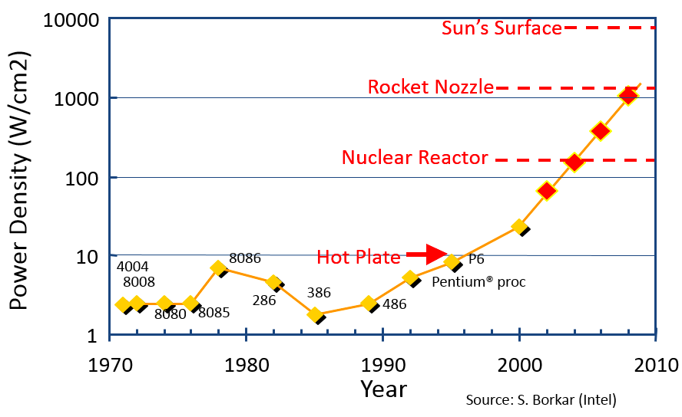
Another Challenge: Power Density
Moore’s law extrapolation
Potential power density reaching amazing levels!
Flip side: battery life very important
Moore’s law can yield more functionality at equivalent (or less) total energy consumption

Slide 20
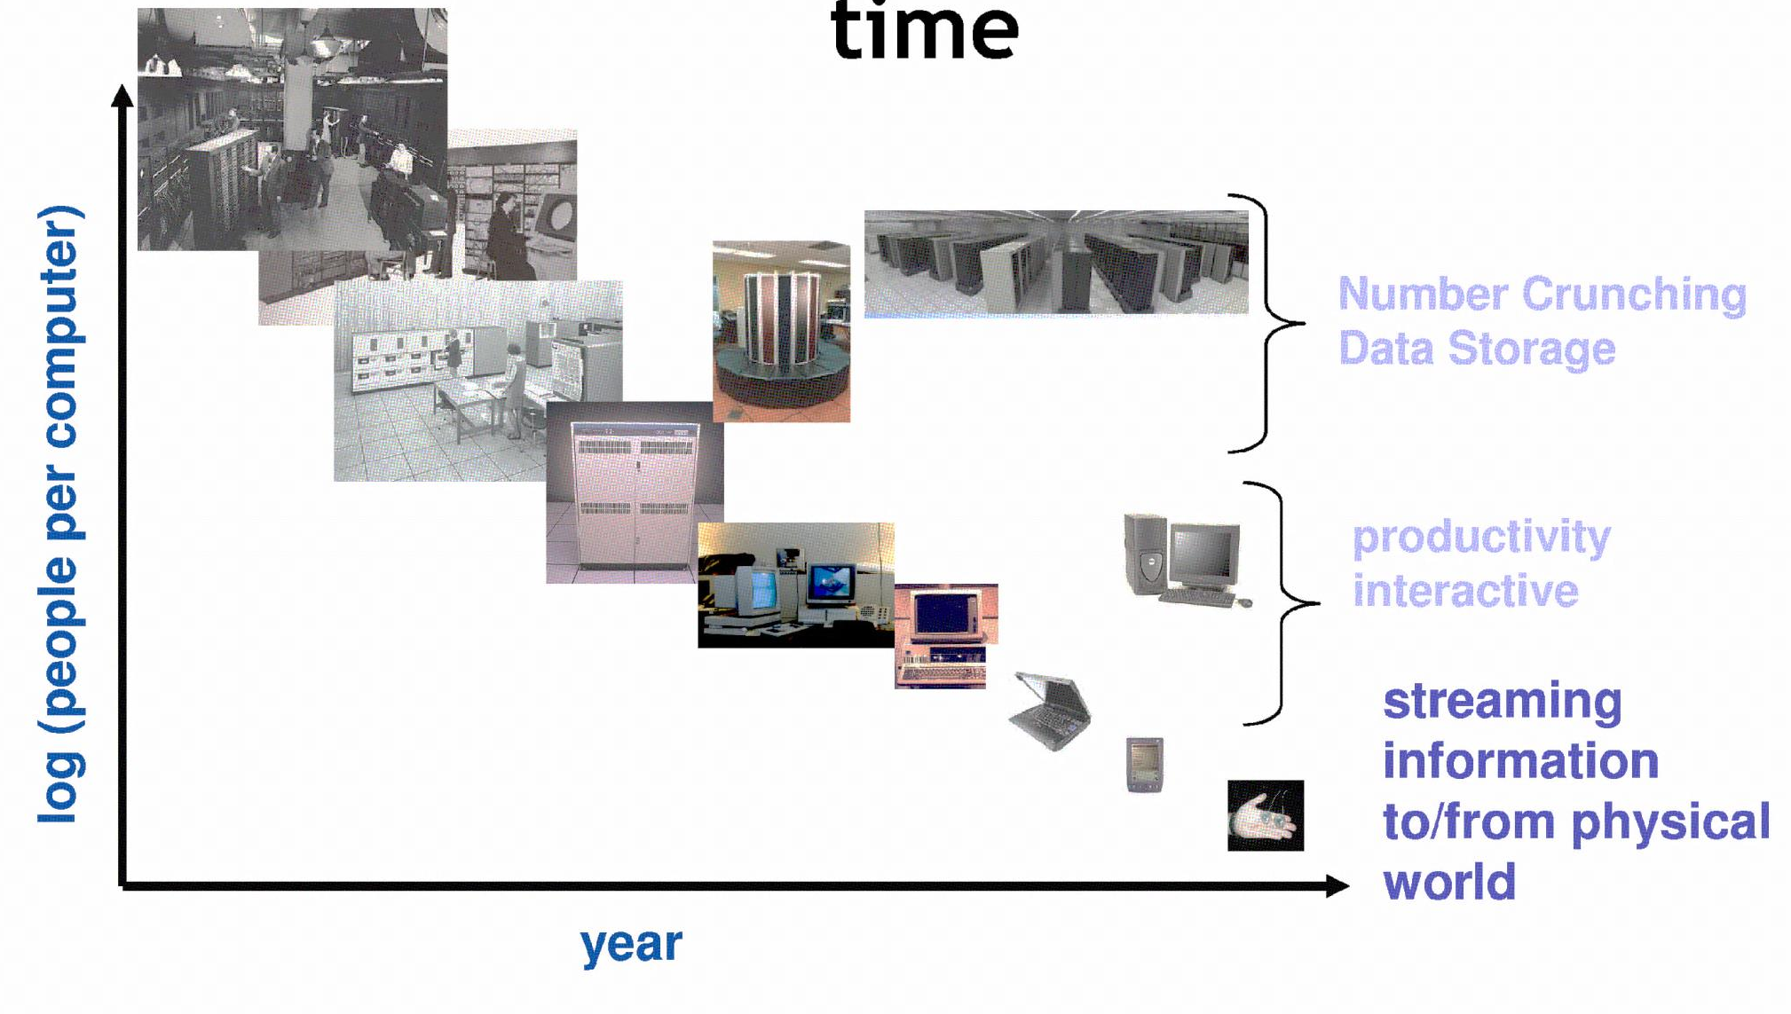
People-to-Computer Ratio Over Time
From David Culler
Today: multiple CPUs/person!
Approaching 100s?

Slide 21
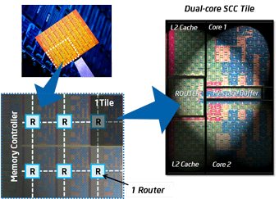
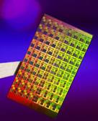
ManyCore Chips: The future is here
Intel 80-core multicore chip (Feb 2007)
80 simple cores
Two FP-engines / core
Mesh-like network
100 million transistors
65nm feature size
Intel Single-Chip Cloud Computer (August 2010)
24 “tiles” with two cores/tile
24-router mesh network
4 DDR3 memory controllers
Hardware support for message-passing
Amazon X1 instances
128 virtual cores, 2 TB RAM
How to program these?
Use 2 CPUs for video/audio
Use 1 for word processor, 1 for browser
76 for virus checking???
Parallelism must be exploited at all levels

Slide 22
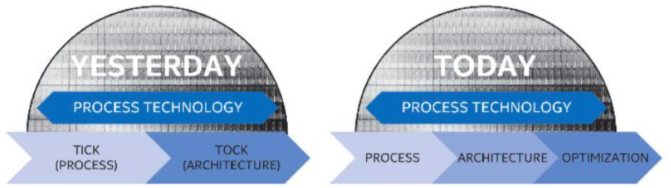
The End of Moore’s Law…
Moore’s Law has (officially) ended -- Feb 2016
No longer getting 2 x transistors/chip every 18 months…
or even every 24 months
May have only 2-3 smallest geometry fabrication plants left:
Intel and Samsung and/or TSMC
Vendors moving to 3D stacked chips
More layers in old geometries
http://files.shareholder.com/downloads/INTC/867590276x0xS50863-16-105/50863/filing.pdf

Slide 23
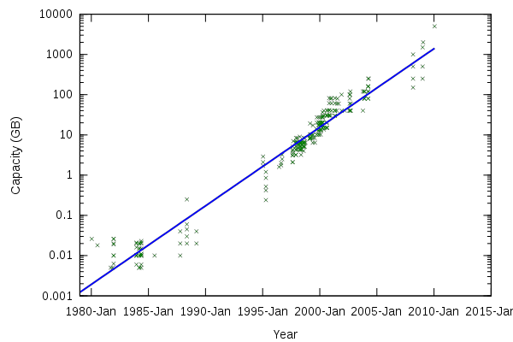
Storage Capacity
Retail hard disk capacity in GB (source: http://www.digitaltonto.com/2011/our-emergent-digital-future/ )

Slide 24
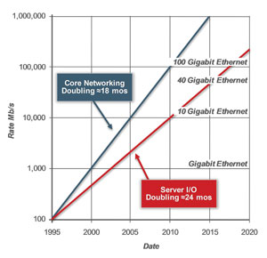
Network Capacity
(source: http://www.ospmag.com/issue/article/Time-Is-Not-Always-On-Our-Side )

Slide 25
Challenge: Complexity
Applications consisting of…
… a variety of software modules that …
… run on a variety of devices (machines) that
… implement different hardware architectures
… run competing applications
… fail in unexpected ways
… can be under a variety of attacks
Not feasible to test software for all possible environments and combinations of components and devices
The question is not whether there are bugs but how serious are the bugs!

Slide 26
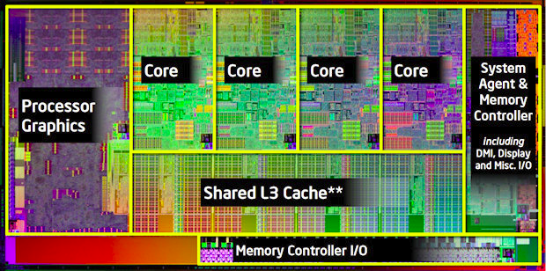
A Modern Processor: Intel Sandy Bridge
Package: LGA 1155
1155 pins
95W design envelope
Cache:
L1: 32K Inst, 32K Data (3 clock access)
L2: 256K (8 clock access)
Shared L3: 3MB – 20MB (not out yet)
Transistor count:
504 Million (2 cores, 3MB L3)
2.27 Billion (8 cores, 20MB L3)
Note that ring bus is on high metal layers – above the Shared L3 Cache

Slide 27
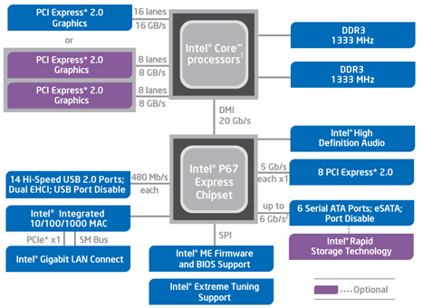
HW Functionality comes with great complexity!
Intel Sandy Bridge I/O
Configuration
Proc
Caches
Busses
adapters
Memory
Controllers
Disks
Displays
Keyboards
I/O Devices:
Networks

Slide 28
5 min break

Slide 29
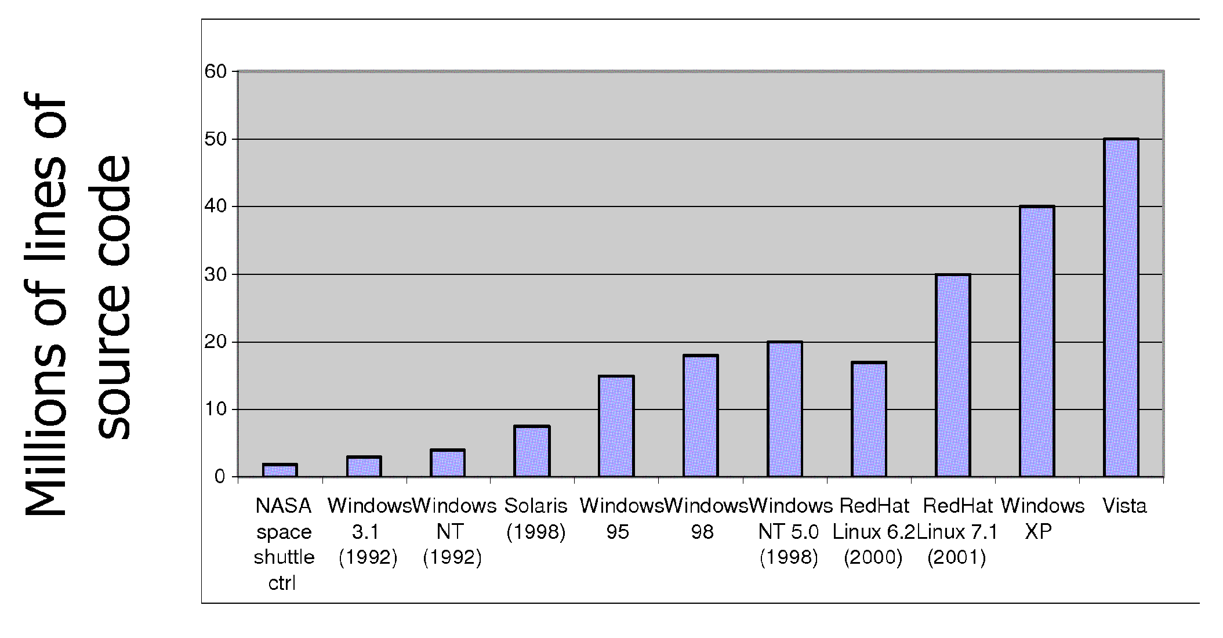
Increasing Software Complexity
From MIT’s 6.033 course

Slide 30
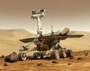
Example: Some Mars Rover (“Pathfinder”) Requirements
Pathfinder hardware limitations/complexity:
20Mhz processor, 128MB of DRAM, VxWorks OS
cameras, scientific instruments, batteries, solar panels, and locomotion equipment
Many independent processes work together
Can’t hit reset button very easily!
Must reboot itself if necessary
Must always be able to receive commands from Earth
Individual Programs must not interfere
Suppose the MUT (Martian Universal Translator Module) buggy
Better not crash antenna positioning software!
Further, all software may crash occasionally
Automatic restart with diagnostics sent to Earth
Periodic checkpoint of results saved?
Certain functions time critical:
Need to stop before hitting something
Must track orbit of Earth for communication
A lot of similarity with the Internet of Things?
Complexity, QoS, Inaccessbility, Power limitations … ?
Notes:
Distance 186 light secs to 21 light minutes one-way
Nearly two earth years

Slide 31
How do we tame complexity?
Every piece of computer hardware different
Different CPU
Pentium, PowerPC, ColdFire, ARM, MIPS
Different amounts of memory, disk, …
Different types of devices
Mice, Keyboards, Sensors, Cameras, Fingerprint readers
Different networking environment
Cable, DSL, Wireless, Firewalls,…
Questions:
Does the programmer need to write a single program that performs many independent activities?
Does every program have to be altered for every piece of hardware?
Does a faulty program crash everything?
Does every program have access to all hardware?

Slide 32
OS Tool: Virtual Machine Abstraction
Application
Operating System
Hardware
Virtual Machine Interface
Physical Machine Interface
Software Engineering Problem:
Turn hardware/software quirks ⇒ what programmers want/need
Optimize for convenience, utilization, security, reliability, etc…
For any OS area (e.g. file systems, virtual memory, networking, scheduling):
What’s the hardware interface? (physical reality)
What’s the application interface? (nicer abstraction)

Slide 33
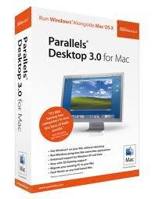
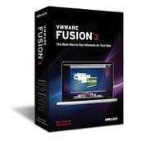
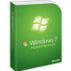
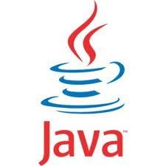
Virtual Machines
Software emulation of an abstract machine
Give programs illusion they own the machine
Make it look like hardware has features you want
Two types of “Virtual Machine”s
Process VM: supports the execution of a single program; this functionality typically provided by OS
System VM: supports the execution of an entire OS and its applications (e.g., VMWare Fusion, Virtual box, Parallels Desktop, Xen)

Slide 34
Process VMs
Programming simplicity
Each process thinks it has all memory/CPU time
Each process thinks it owns all devices
Different devices appear to have same high level interface
Device interfaces more powerful than raw hardware
Bitmapped display ⇒ windowing system
Ethernet card ⇒ reliable, ordered, networking (TCP/IP)
Fault Isolation
Processes unable to directly impact other processes
Bugs cannot crash whole machine
Protection and Portability
Java interface safe and stable across many platforms

Slide 35
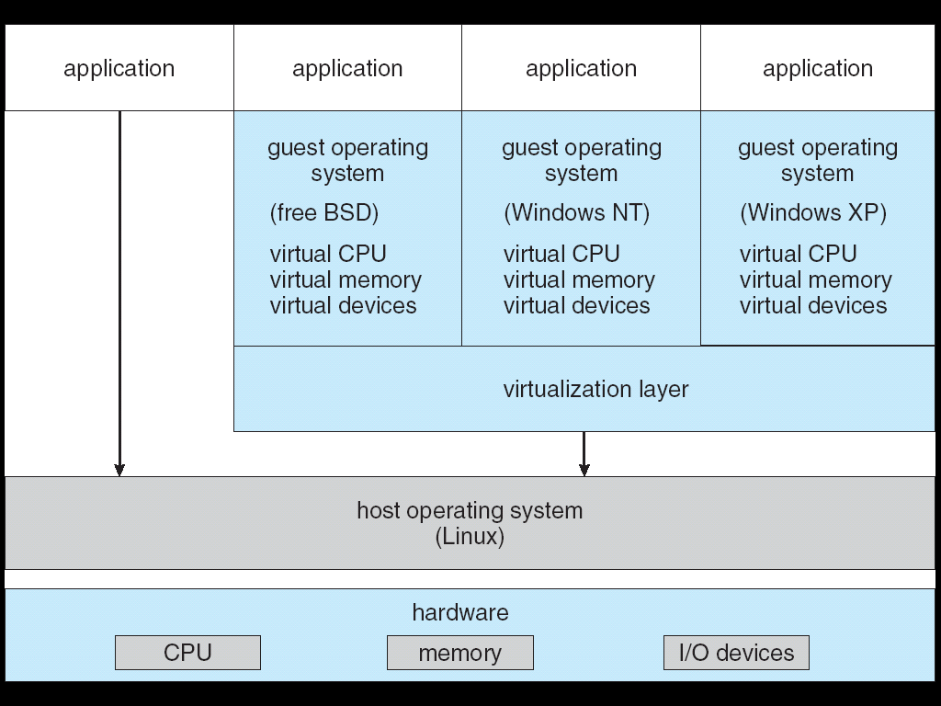
System Virtual Machines: Layers of OSs
Useful for OS development
When OS crashes, restricted to one VM
Can aid testing programs on other OSs

Slide 36
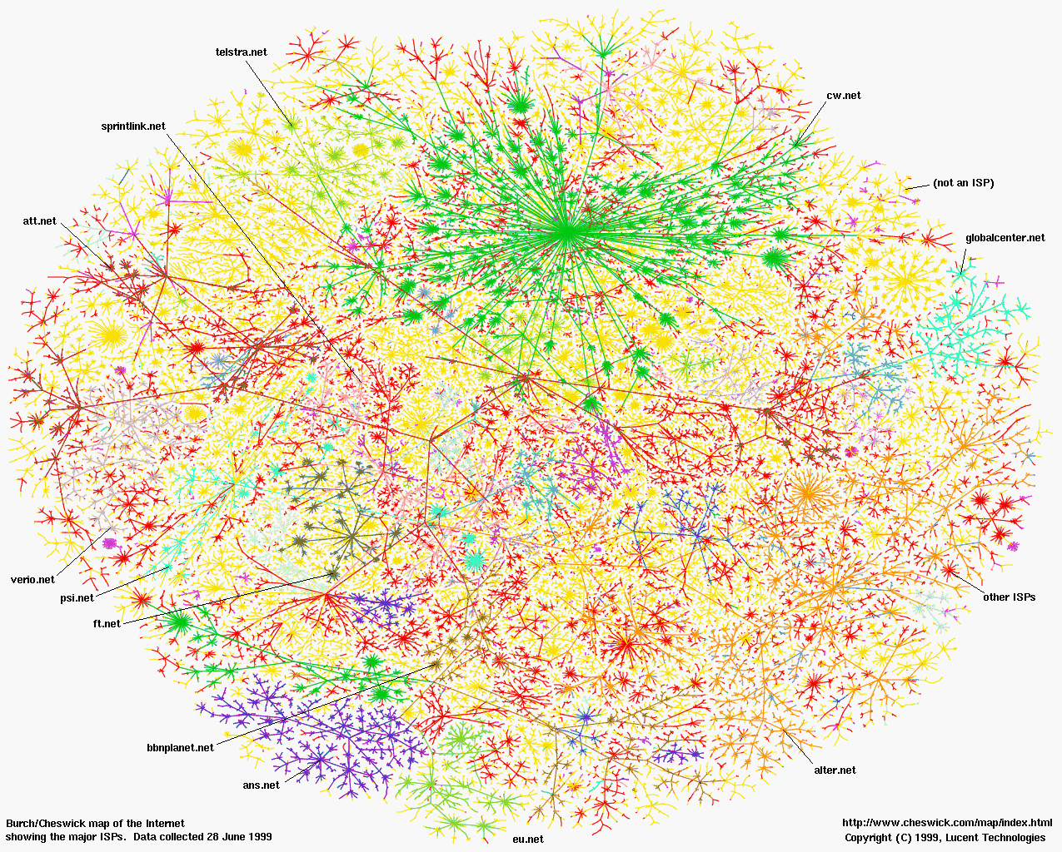
Greatest Artifact of Human Civilization…

Slide 37

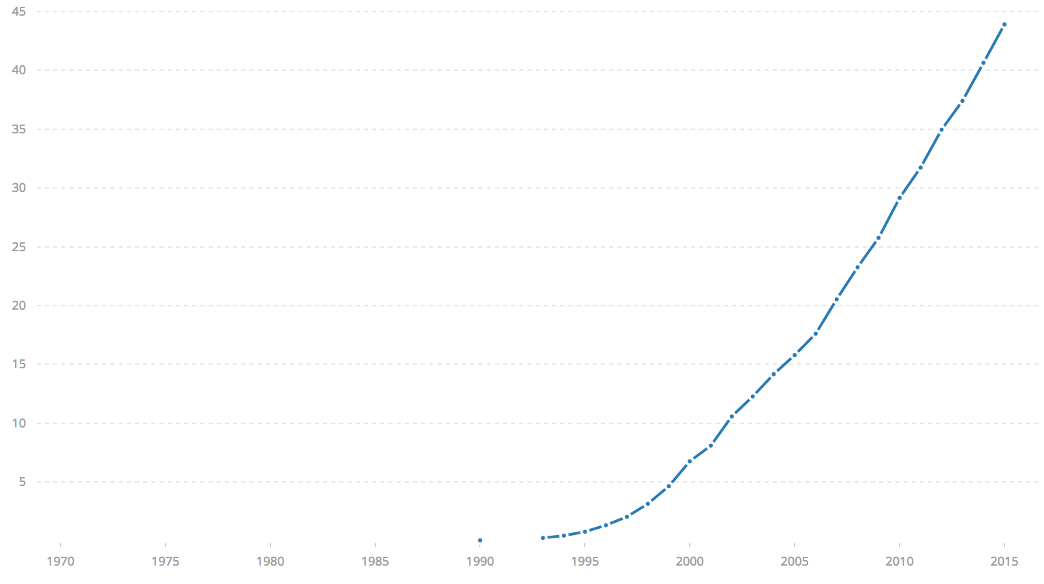

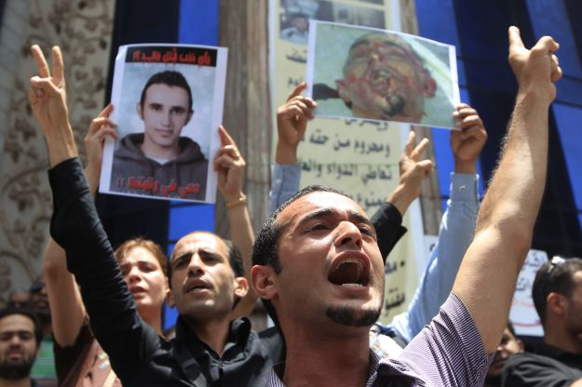
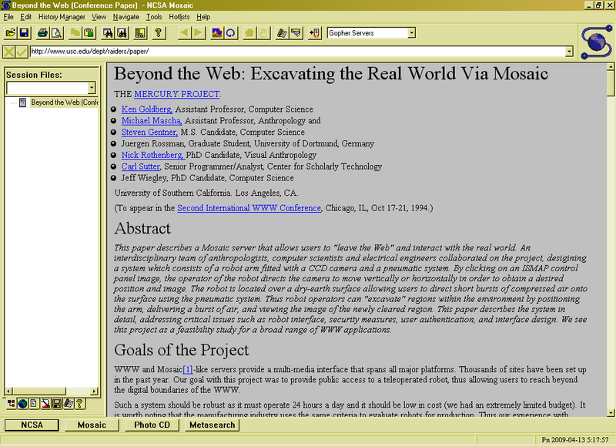
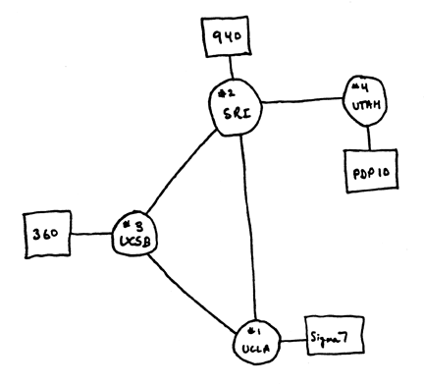
Internet Scale: Over 3.8 Billion Users!
% of world’s
population
3.8 B
ARPANet
Internet
WWW
2.0 B 1/26/11
RFC 675 TCP/IP
HTTP 0.9
1969
1974
1990
2017

Slide 38
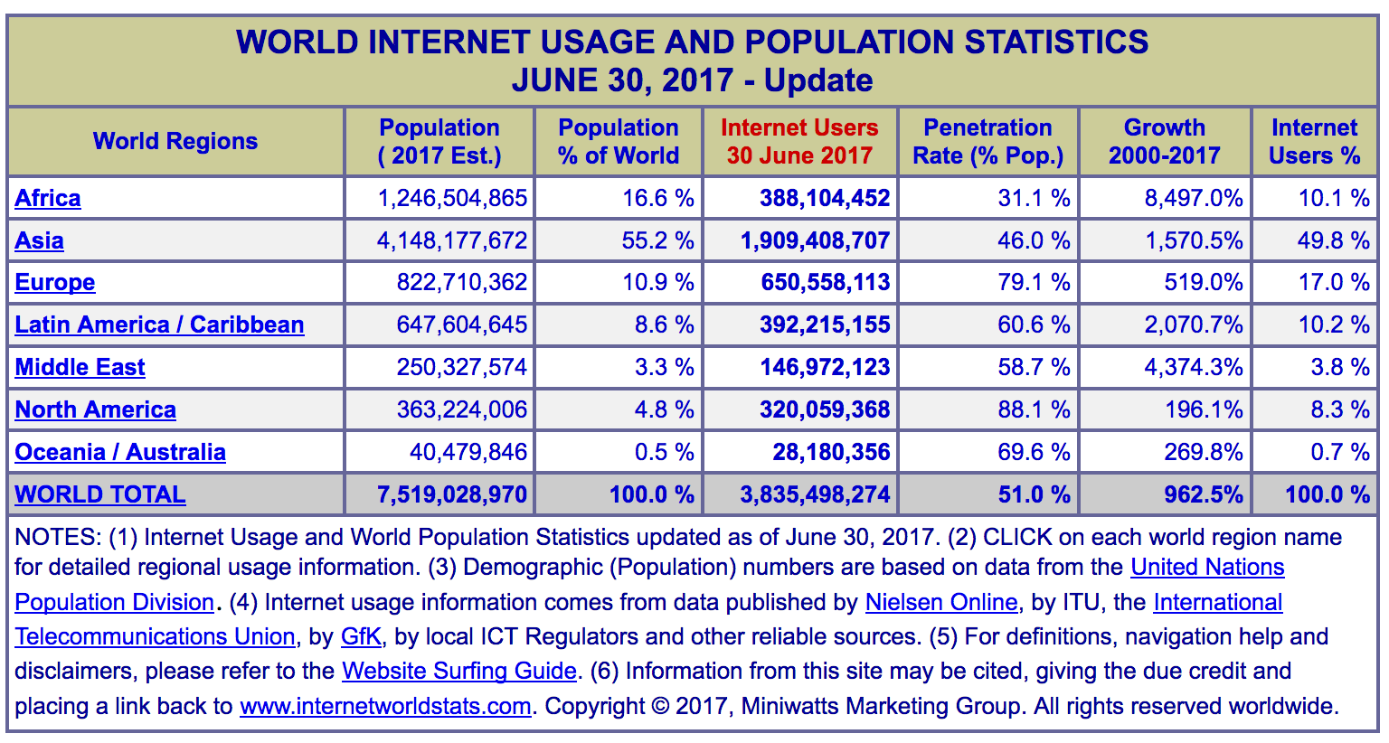
Internet Scale: Over 3.8 Billion Users!
(source: http://www.internetworldstats.com/stats.htm)

Slide 39
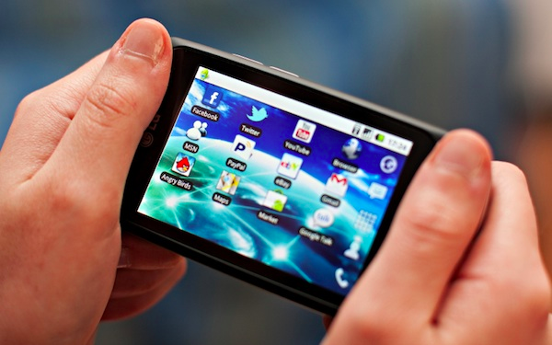
Not Only PCs connected to the Internet
Smartphone shipments exceed PC shipments!
2011 shipments:
487M smartphones
414M PC clients
210M notebooks
112M desktops
63M tablets
25M smart TVs
4 billion phones in the world → smartphone over next decade
373.1 million in Q3 2017
70.6 million in Q4 2017
52.9 million in Q4 2017
222 million in 2016

Slide 40
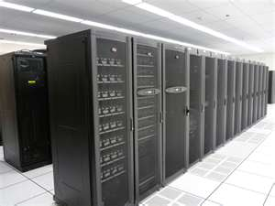
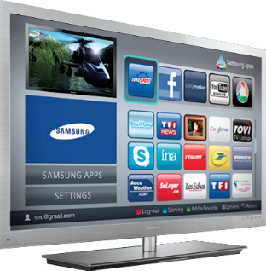
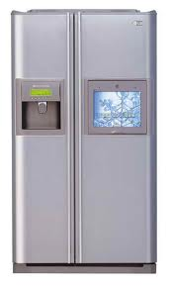
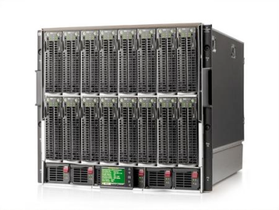
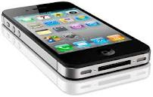
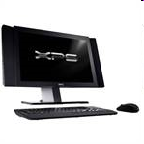
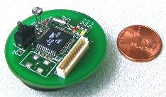
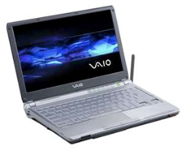
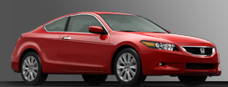
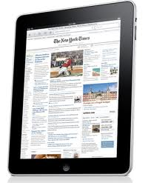


Societal Scale Information Systems (Or the “Internet of Things”?)
Massive Cluster
The world is a large distributed system
Microprocessors in everything
Vast infrastructure behind them
Gigabit Ethernet
Clusters
Massive Cluster
Clusters
Gigabit Ethernet
Internet Connectivity
Scalable, Reliable,
Secure Services
Databases
Information Collection
Remote Storage
Online Games
Commerce
…
MEMS for
Sensor Nets
Notes:
Of the enormous variety of CITRIS projects going on at Berkeley, I will present one set that is tied together by this picture: the design, construction and use of MEMS devices, the sensor networks containing them, and making the information from these networks available to widely distributed users as scalable, reliable and secure services.
The name we give to such an integrated system is a Societal Scale Information System, a name meant to evoke its scale – enormous - and purpose – benefiting people and the economy.
I will leave the details of all the specific applications that Ruzena mentioned, be it to energy efficiency or education or disaster response the social sciences, and indeed most details, to later talks and posters.

Slide 41





Example: What’s in a Search Query?
DNS
Servers
Datacenter
DNS
request
create
result
page
Search
Index
Page store
Load
balancer
Ad Server
Complex interaction of multiple components in multiple administrative domains
Systems, services, protocols, …
Notes:
In this course we are not focusing on a single node system but on the end-to-end system. The reason is very simple: today the majority of applications we use does not run on our system. Social networks, e-mail, google docs, online gamming, etc.

Slide 42


Infrastructure, Textbook & Readings
Infrastructure
Website: http://cs162.eecs.berkeley.edu
Piazza: https://piazza.com/berkeley/spring2018/cs162
Webcast: Cal Central - https://calcentral.berkeley.edu/academics/teaching-semester/spring-2018/class/compsci-162
Textbook: Operating Systems: Principles and Practice (2nd Edition) Anderson and Dahlin
Recommend: Operating Systems Concepts, 9th Edition Silbershatz, Galvin, Gagne
Copies in Bechtel
Online supplements
See course website
Includes Appendices, sample problems, etc.
Networking, Databases, Software Eng, Security
Some Research Papers!

Slide 43
Syllabus
OS Concepts: How to Navigate as a Systems Programmer!
Process, I/O, Networks and Virtual Machines
Concurrency
Threads, scheduling, locks, deadlock, scalability, fairness
Address Space
Virtual memory, address translation, protection, sharing
File Systems
I/O devices, file objects, storage, naming, caching, performance, paging, transactions, databases
Distributed Systems
Protocols, N-Tiers, RPC, NFS, DHTs, Consistency, Scalability, multicast
Reliability & Security
Fault tolerance, protection, security
Cloud Infrastructure

Slide 44
Learning by Doing
Individual Homeworks: Learn Systems Programming
0. Tools, Autograding, recall C, executable
1. Simple Shell
2. Web server
3. Memory allocation
Three Group Projects (Pintos in C)
1. Threads & Scheduling
2. User-programs
3. File Systems

Slide 45
Group Project Simulates Industrial Environment
Project teams have 4 members (try really hard to find 4 members – 3 members requires serious justification)
Must work in groups in “the real world”
Same section much preferred
Communicate with colleagues (team members)
Communication problems are natural
What have you done?
What answers you need from others?
You must document your work!!!
Communicate with supervisor (TAs)
What is the team’s plan?
What is each member’s responsibility?
Short progress reports are required
Design Documents: High-level description for a manager!

Slide 46
Getting started
Start homework 0, this Friday, 1/19
Github account
Registration survey
Vagrant virtualbox – VM environment for the course
Consistent, managed environment on your machine
Get familiar with all the cs162 tools
Submit to autograder via git
Start forming a project group

Slide 47
Grading
Point distribution subject to change
42% three midterms (14% each) – ALL DATES AND TIMES ARE TENTATIVE
Wednesday, 2/28, 6:30-8p, TUESDAY, 3/20, 6:30-8p (no class), Monday, 4/23, 6:30-8p (no class)
35% projects
15% homework
8% participation
No final exam
Projects
Initial design document, Design review, Code, Final design
Submission via git push triggers autograder

Slide 48
Personal Integrity
UCB Academic Honor Code: "As a member of the UC Berkeley community, I act with honesty, integrity, and respect for others."
http://asuc.org/honorcode/resources/HC%20Guide%20for%20Syllabi.pdf

Slide 49


CS 162 Collaboration Policy
Explaining a concept to someone in another group
Discussing algorithms/testing strategies with other groups
Helping debug someone else’s code (in another group)
Searching online for generic algorithms (e.g., hash table)
Sharing code or test cases with another group
Copying OR reading another group’s code or test cases
Copying OR reading online code or test cases from prior years
We compare all project submissions against prior year submissions and online solutions and will take actions (described on the course overview page) against offenders

Slide 50
Lecture Goal
Interactive!!!

Slide 51



What is an Operating System?
Referee
Manage sharing of resources, Protection, Isolation
Resource allocation, isolation, communication
Illusionist
Provide clean, easy to use abstractions of physical resources
Infinite memory, dedicated machine
Higher level objects: files, users, messages
Masking limitations, virtualization
Glue
Common services
Storage, Window system, Networking
Sharing, Authorization
Look and feel

Slide 52
What is an Operating System,… Really?
Most Likely:
Memory Management
I/O Management
CPU Scheduling
Communications? (Does Email belong in OS?)
Multitasking/multiprogramming?
What about?
File System?
Multimedia Support?
User Interface?
Internet Browser? ☺
Is this only interesting to Academics??

Slide 53
Operating System Definition (Cont.)
No universally accepted definition
“Everything a vendor ships when you order an operating system” is good approximation
But varies wildly
“The one program running at all times on the computer” is the kernel
Everything else is either a system program (ships with the operating system) or an application program

Slide 54
“In conclusion…”
Operating systems provide a virtual machine abstraction to handle diverse hardware
Operating systems simplify application development by providing standard services
Operating systems coordinate resources and protect users from each other
Operating systems can provide an array of fault containment, fault tolerance, and fault recovery
CS162 combines things from many other areas of computer science:
Languages, data structures, hardware, and algorithms

